Slide 1


Design of Radial Basis Function with the Aid of Fuzzy KNN and Conditional FCM
Ha-Rang Kim
25.5.18
ⓒSaebyeol Yu. Saebyeol’s PowerPoint

Slide 2
Table of contents
1
Background of study
2
Algorithm
3
Experiment

Slide 3
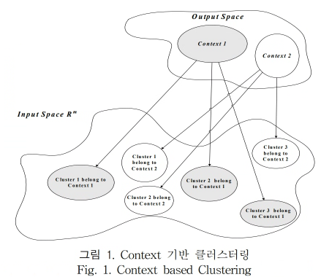
RBFNN with the Aid of KNN and CFCM
1.Background
CFCM clustering cannot project the information which is extracted over the output space into the input space
we apply a fuzzy K-nearest neighbors approach to project the auxiliary information defined over the output space into the input space without lose of the information.

Slide 4
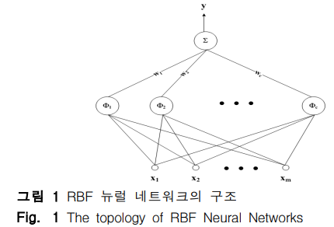


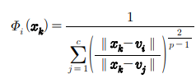
RBFNN with the Aid of KNN and CFCM
2.Algorithm - RBFNN
Receptive field
Receptive field (Form of FCM function)

Slide 5
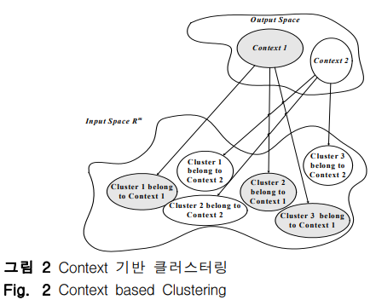
RBFNN with the Aid of KNN and CFCM
2. Algorithm - CFCM
Unsupervised learning : doesn’t use auxiliary information from output space.
In RBFNN, using auxiliary information from output space -> Better performance
FCM : unsupervised learning -> could not use information -> CFCM
(Auxiliary information = context)
Classifying data pattern in the CFCM
Consideration 1. context 2. data distribution in input space

Slide 6

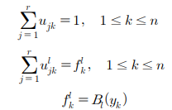

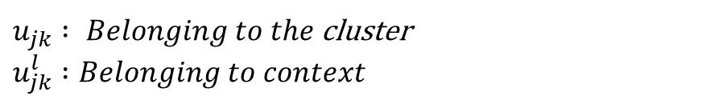

RBFNN with the Aid of KNN and CFCM
2. Algorithm – CFCM
Objective function
(defined in the fuzzy set defined in output space)
B = context
$u_{jk} : Belonging to the$cluster $u_{jk}^{l} :Belonging to context$
MF of context (yk)

Slide 7
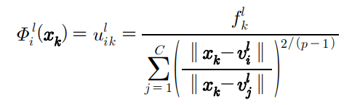
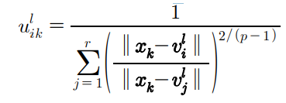
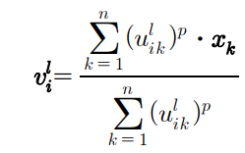
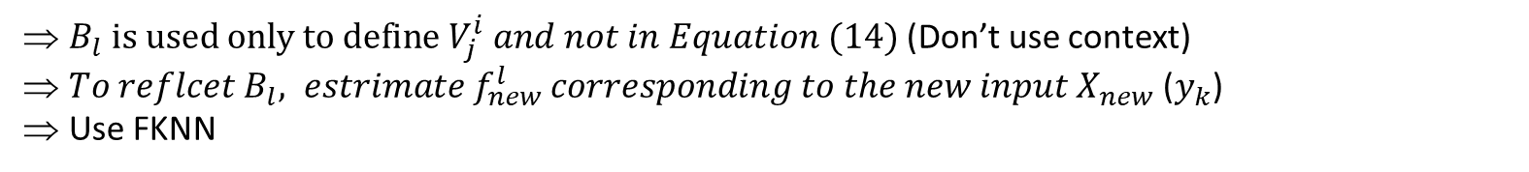
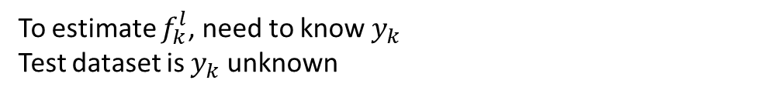
Conditional Fuzzy C-Means
2. Algorithm - CFCM
To estimate $f_{k}^{l}$, need to know $y_{k}$
Test dataset is $y_{k}$unknown
=>
(14)
$B_{l} is used only to define V_{j}^{i} and not in Equation (14)$(Don’t use context)
${To reflcet B}_{l}, estrimate f_{new}^{l} corresponding to the new input X_{new}$ ($y_{k}$)
Use FKNN

Slide 8

Conditional Fuzzy C-Means
2. Algorithm – Fuzzy KNN
The method of extracting additional information in the output space = information granulation in the output space
=> 1. Evenly partition 2. k-means
Tendency to fail to reflect the distribution patterns of the data
=> 2. K-means
Evenly partition
The space between the maximum and minimum values in the output space is uniformly divided into a predefined number of intervals.
Reflect data distribution
Irregular distribution of the vertices of the divided context

Slide 9
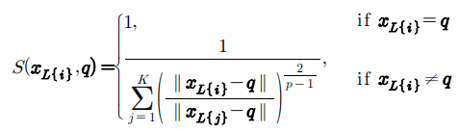

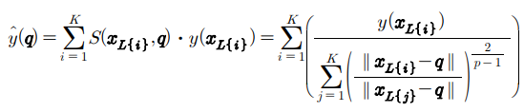
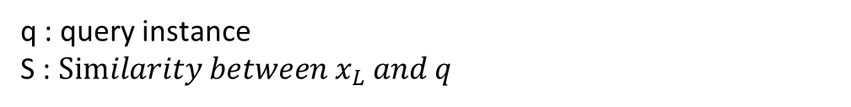
Conditional Fuzzy C-Means
2. Algorithm – Fuzzy KNN
q : query instance
S : $Similarity between x_{L} and q$

Slide 10
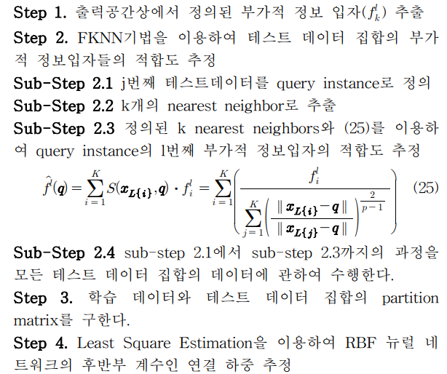
Conditional Fuzzy C-Means
2. Algorithm

Slide 11

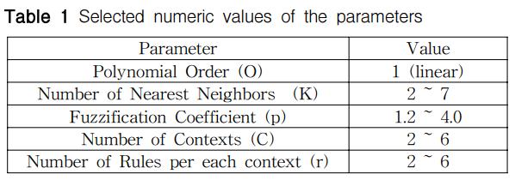
Conditional Fuzzy C-Means
3. Experiment

Slide 12
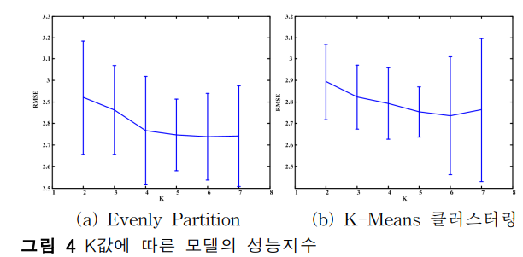
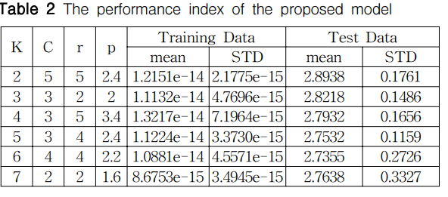
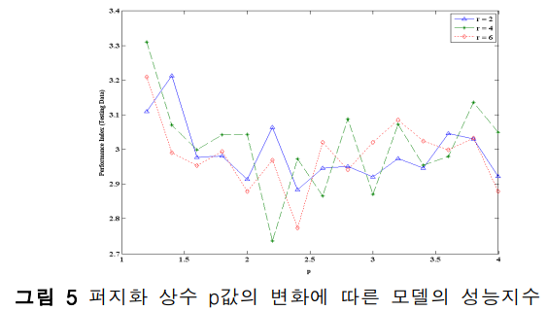
Conditional Fuzzy C-Means
3. Experiment
Automobile MPG (Miles Per Gallon) Data
60% : training data
40% : test data
(arbitrary division, 10times)
K increase -> Performance generally increase
C : 4, K : 4, k-means

Slide 13
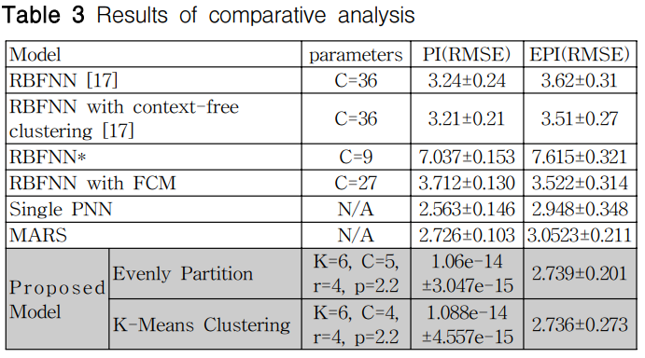
Conditional Fuzzy C-Means
3. Experiment
Matlab toolbox

